Slide 1
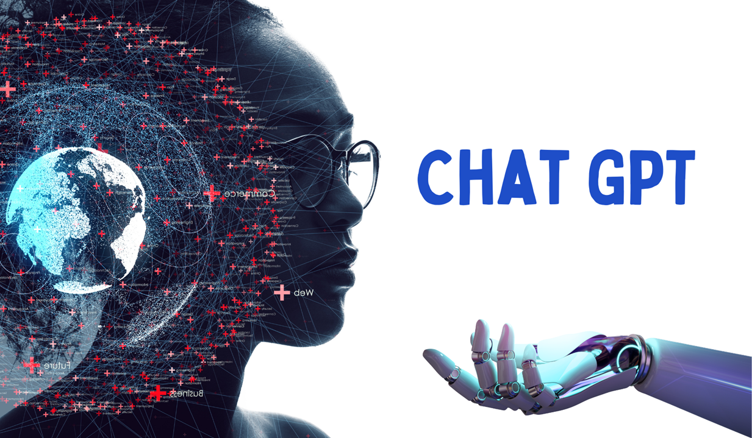

Slide 2
Agenda
Introduction
Architecture & Design
Training Phases
Applications

Slide 3
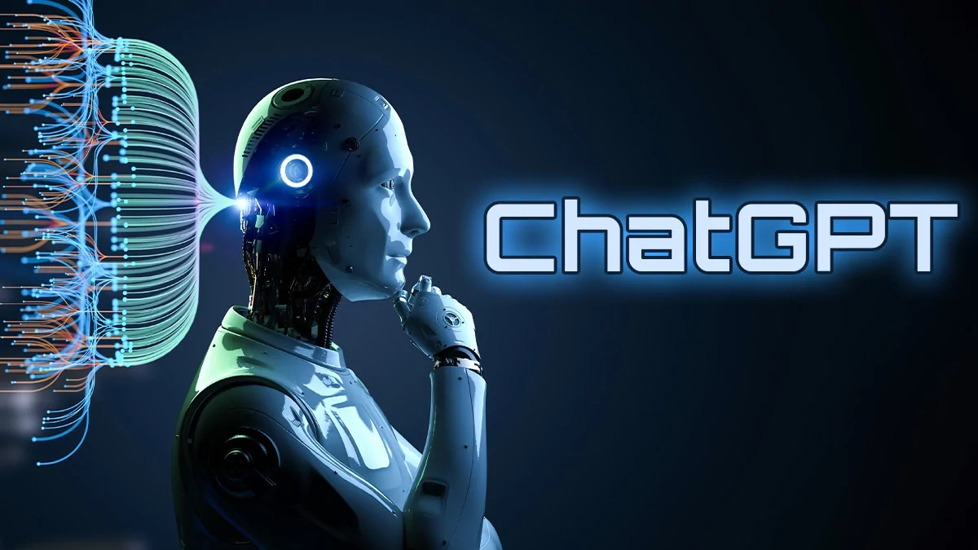
INTRODUCTION:
ChatGPT (Generative Pretrained Transformer) is a state-of-the-art language model developed by OpenAI, a leading research organization in the field of artificial intelligence.
The model is based on the transformer architecture and has been trained on a massive amount of text data from the internet.
This training has enabled ChatGPT to generate human-like text responses to a given prompt, making it an important tool for a wide range of natural language processing tasks, including conversation, question answering, summarization, and text generation
ChatGPT has been trained using unsupervised learning, which means that it has not been explicitly programmed with specific rules or knowledge, but instead has learned patterns and relationships in the text data it was trained on.
ChatGPT is used by businesses, researchers, and developers to build conversational AI applications such as chatbots and virtual assistants. It is also used as a research tool in the field of natural language processing.

Slide 4
THE TECHNICAL OVERVIEW OF CHATGPT INVOLVES UNDERSTANDING ITS ARCHITECTURE, DESIGN, AND TRAINING PROCESS.
Architecture: ChatGPT is based on the transformer architecture, which is a neural network architecture designed specifically for processing sequences of data, such as text.
The transformer architecture uses a self-attention mechanism, which allows the model to focus on different parts of the input sequence when making predictions.
This makes the model highly effective at capturing relationships between words and phrases in a sentence, which is critical for generating coherent and meaningful text responses.
Design: ChatGPT has been designed as a generative model, meaning that it is capable of generating new text, as opposed to simply classifying or identifying existing text.
The model is trained to predict the next word in a sequence, given the previous words, and it uses this training to generate text that is similar to the text it was trained on.
The model uses a combination of dense and recurrent neural networks, as well as the transformer architecture, to achieve this goal.

Slide 5
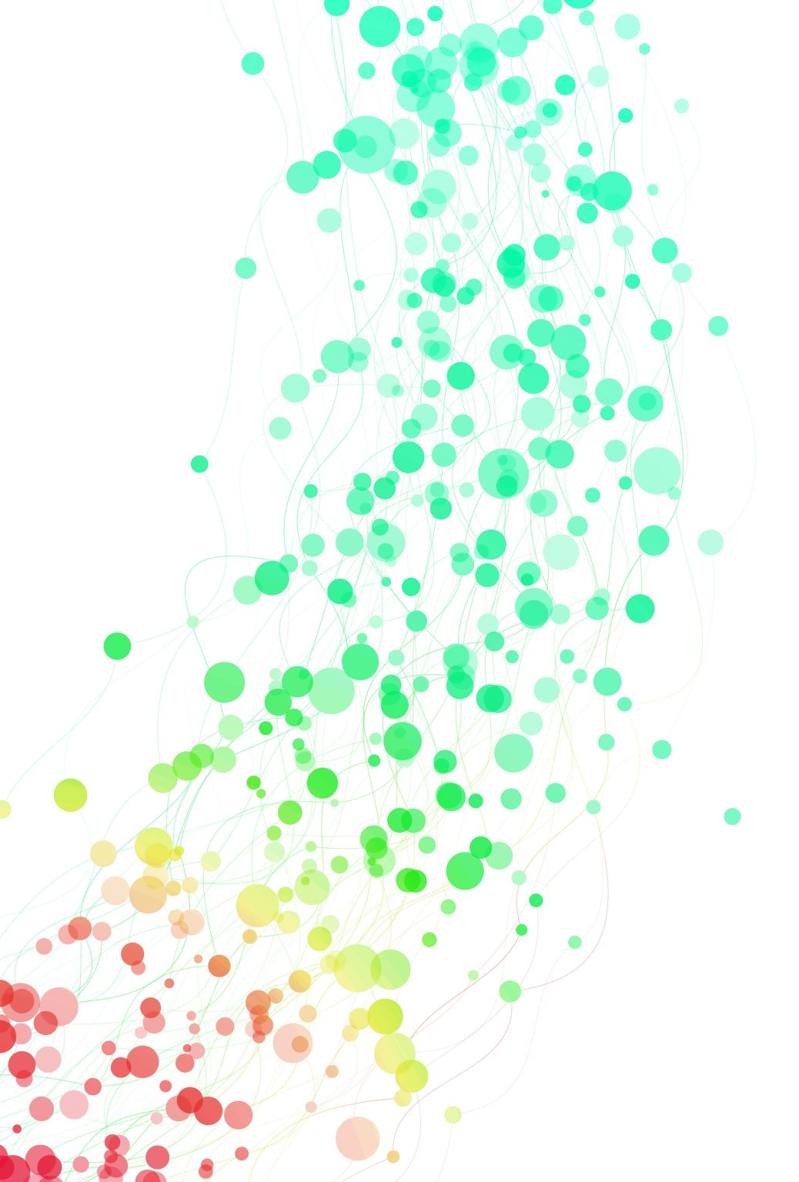
Training Process
ChatGPT was trained using unsupervised learning, which means that it was trained on a massive amount of text data without explicit supervision.
During training, the model was presented with a large corpus of text and was trained to predict the next word in a sequence, given the previous words.
This process allowed the model to learn the relationships and patterns in the text data it was trained on, giving it the ability to generate coherent and meaningful text.
Overall, the technical overview of ChatGPT highlights the key features and capabilities of the model, as well as the architecture and design that make it a powerful tool for natural language processing tasks.
These capabilities have made ChatGPT a popular choice for businesses, researchers, and developers who are looking to build conversational AI applications, such as chatbots and virtual assistants.

Slide 6

CHATGPT HAS A WIDE RANGE OF APPLICATIONS AND USE CASES, INCLUDING:
Conversational AI and Chatbots: ChatGPT is widely used for building conversational AI applications, such as chatbots, virtual assistants, and customer service bots.
The model's ability to generate human-like text responses makes it an ideal tool for building conversational AI applications that can understand and respond to user inputs in a natural and intuitive way.
Virtual Assistants: Virtual assistants powered by ChatGPT can perform a wide range of tasks, including scheduling appointments, booking travel, answering questions, and providing information.
These virtual assistants can be integrated into existing platforms, such as messaging apps, or can be built into standalone applications.
Text Generation and Summarization: ChatGPT can be used to generate new text or to summarize existing text.
For example, it can be used to generate new articles, stories, or poetry, or to summarize news articles or scientific papers.

Slide 7
ADVANTAGES OF CHATGPT INCLUDE
Human-Like Text Generation: One of the key advantages of ChatGPT is its ability to generate human-like text that is coherent and meaningful.
This makes it a powerful tool for building conversational AI applications and virtual assistants that can interact with users in a natural and intuitive way.
Wide Range of Applications: ChatGPT has a wide range of applications and can be used for a variety of natural language processing tasks, including conversation, text generation, summarization, and more.
This versatility and flexibility make it an ideal tool for businesses, researchers, and developers who are looking to build AI applications.
Large Training Data: ChatGPT was trained on a massive amount of text data, which gives it a broad understanding of the relationships and patterns in the data.
This allows the model to generate text that is diverse and reflective of the training data, making it an effective tool for a wide range of use cases.
High Performance: ChatGPT has been designed and optimized for speed and efficiency, making it an ideal tool for building real-time conversational AI applications.
The model can generate text responses quickly and accurately, which allows users to receive fast and accurate answers to their questions and requests.

Slide 8
LIMITATIONS OF CHATGPT INCLUDE:
Bias in Training Data: ChatGPT was trained on a large amount of text data from the internet, which may contain biases and stereotypes. This can result in the model generating text that reflects these biases, which can be problematic in certain applications, such as virtual assistants or chatbots that interact with diverse groups of users.
Lack of Context Awareness: ChatGPT is trained to generate text based on the input sequence it is given, but it does not have a sense of context or an understanding of the world. This can result in the model generating text that is not relevant or appropriate in certain situations.
Limited Explainability: As a deep learning model, ChatGPT is a black box that can be difficult to understand and explain. This can make it challenging to diagnose and address errors or biases in the model's predictions.
Dependence on Large Computational Resources: Training large language models like ChatGPT requires significant computational resources, including large amounts of memory and processing power. This can make it difficult for smaller organizations or individuals to develop and train similar models.
Question Answering and Knowledge Base: ChatGPT can be used to answer questions by using its knowledge of the text data it was trained on. It can be integrated into knowledge base systems, such as FAQ systems or customer service portals, to provide quick and accurate answers to user questions.

Slide 9
Other Applications: ChatGPT has a wide range of other applications, including text classification, sentiment analysis, language translation, and more. The versatility and flexibility of the model make it an ideal tool for a variety of natural language processing tasks.
In conclusion, ChatGPT is a powerful and versatile language model developed by OpenAI. Its ability to generate human-like text and its wide range of applications make it a valuable tool for businesses, researchers, and developers looking to build AI applications. The model has been trained on a massive amount of text data, giving it a broad understanding of language patterns and relationships.
However, it is important to consider the limitations of ChatGPT, such as the potential for biases in the training data and the lack of context awareness and explainability. Additionally, training large language models like ChatGPT requires significant computational resources, making it difficult for smaller organizations or individuals to develop and train similar models.
Overall, ChatGPT represents a significant advance in the field of artificial intelligence and has the potential to revolutionize the way we interact with machines. As the field of AI continues to advance, it is likely that ChatGPT will continue to play a significant role in the development of new and innovative applications.

Slide 10
THANK YOU

